Slide 1

What can I do with the Blockchain?
For developers and industry professionals!
By Mila Paul

Slide 2
Who am I ?
Computer science
Defense contracting
Cyber Operations
Blockchain startups!

Slide 3
What will we talk about today?
What is Blockchain
Different kinds of Blockchain
Make a smart contract on Ethereum!

Slide 4
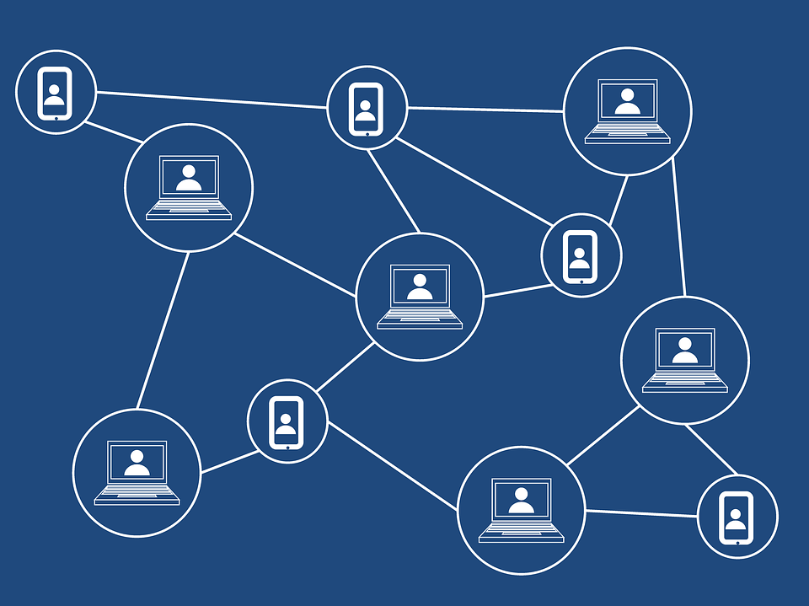

Bitcoin vs Blockchain
Blockchain
Bitcoin
An electronic cash system
Front end software
Bank example: your money
Used by investors
Holds the transaction records of the cash system
Back end software
Bank example: bank database records
The real technology!

Slide 5

We are here to talk about Blockchain NOT financial investments!

Slide 6
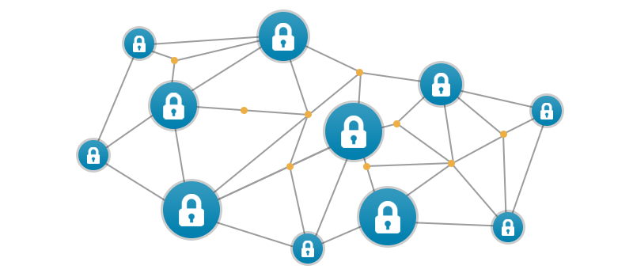

The Bitcoin Core

Slide 7
Bitcoin Core's Fundamental Properties
Decentralized
Immutable
Trustless

Slide 8
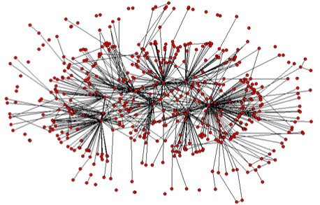
Decentralized
No Central Authority
Public nodes
Bank example

Slide 9
Immutable
Tamper Proof
Encrypted
Bank example
Transparent

Slide 10
Trustless
Consensus
Cryptographic validation
Merkle Hash Tree

Slide 11
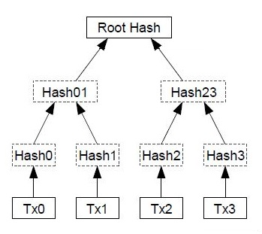
Merkle Tree!

Slide 12

Bitcoin Core
https://github.com/bitcoin/bitcoin
Blockchain
Decentralized Application
Coin

Slide 13
Different kinds of Blockchains
Bitcoin Core
https://github.com/bitcoin/bitcoin
C++
Ethereum
https://github.com/ethereum/
Go
Hyperledger
https://github.com/hyperledger
Various (C, Rust, Go)

Slide 14

Explore on Github
Bitcoin Core
Ethereum
Hyperledger

Slide 15

The Ethereum Blockchain
Made for Developers
Platform to create Blockchain Applications
More than just cash transactions!

Slide 16
Two Types of Objects in Ethereum
Accounts
Address (public key)
Private key
Smart Contracts
Address
Program

Slide 17
Smart Contracts
Algorithmic Enforcement of agreements
Human cooperation
Automates a physical contract
Trustless, Immutable, Decentralized

Slide 18
Smart Contract – The Software Program
Language – Solidity
Compiler – Remix
Container/VM - Ethereum Virtual Machine

Slide 19
Ethereum Virtual Machine (EVM) Process
Solidity is compiled to EVM bytecode
EVM processes the transactions
Transaction is validated by consensus
EVM changes state

Slide 20
EVM Building Blocks
Foundation
Accounts
Contracts
Transactions
Account -> Account
Contract -> Contract
Types of Contracts
Message
Process with Ruleset
Account -> Contract
Contract -> Account

Slide 21
Enough Talking! Let’s Code!

Slide 22
IDEs for Solidity
Remix
Mist
Truffle

Slide 23
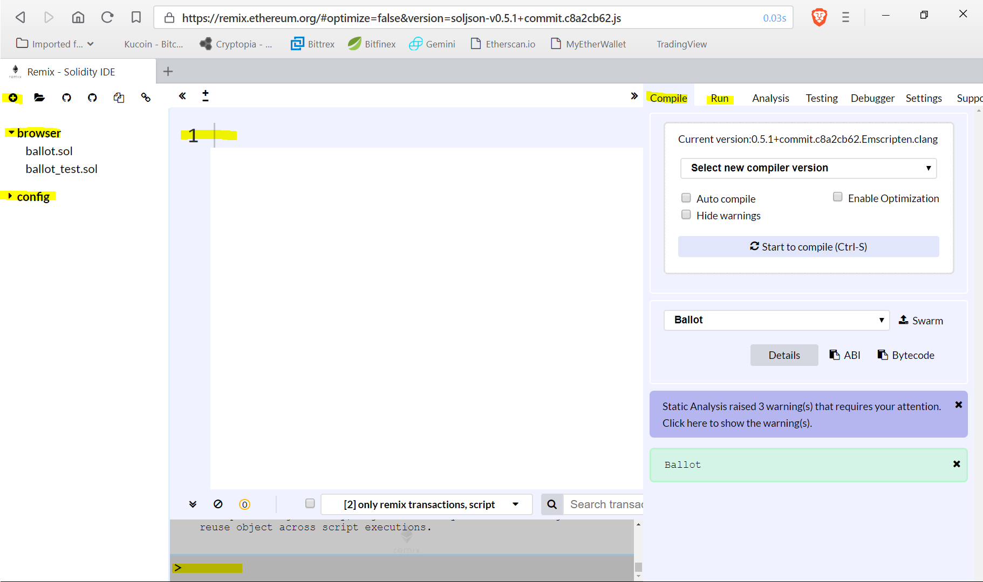

Slide 24
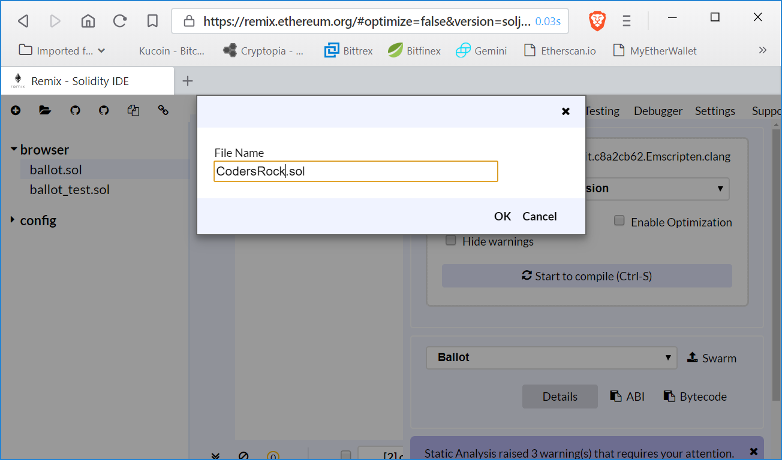
Create a new File. Java naming convention

Slide 25
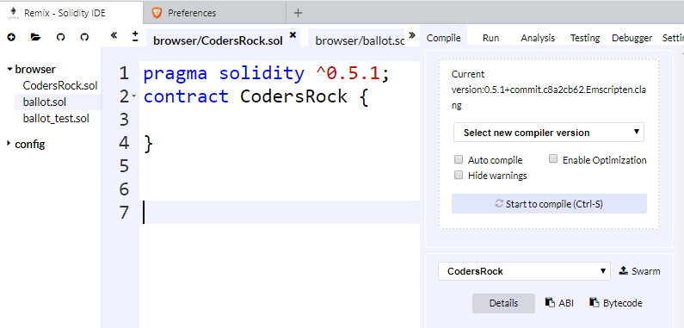
Set up contract CodersRock

Slide 26
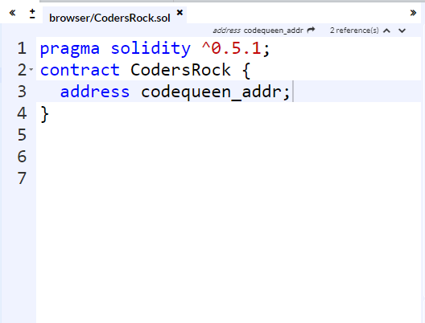

Variable datatype address

Slide 27
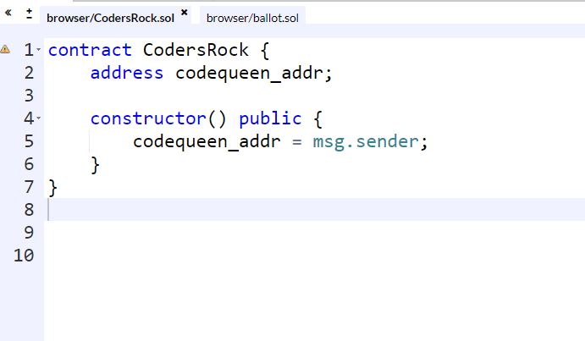
Create your constructor

Slide 28
What is msg.sender
Contract deployer/creator is the owner
msg.sender refers to the contract owner

Slide 29
Getter function for the address

Slide 30
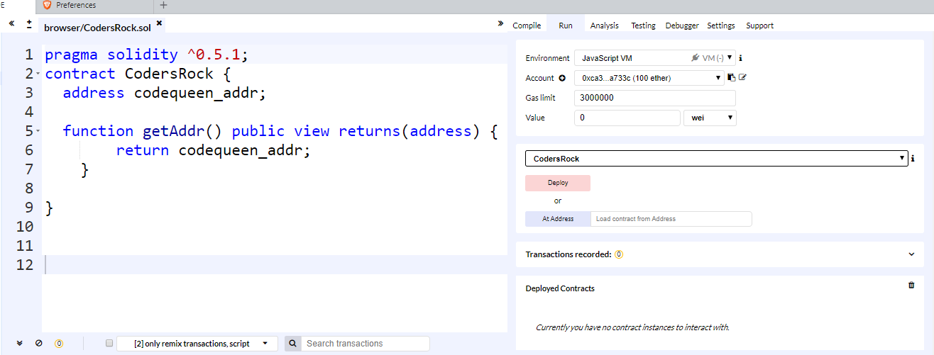
Let’s run it!

Slide 31
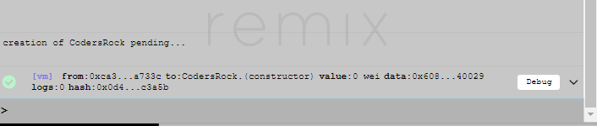
Create an instance of your smart contract

Slide 32
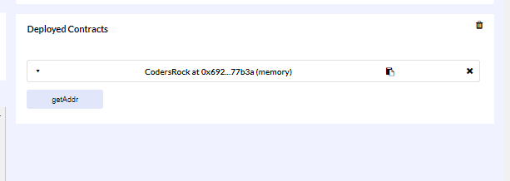
Your new contract

Slide 33
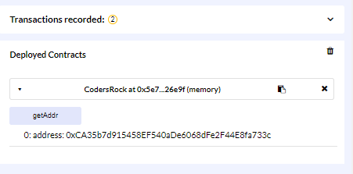
Info from getAddr function

Slide 34
Print a message
Let’s try it!!!
Notes:
string hello = "solidity is awesome";

Slide 35
Answer
Can you fix the issue with the output?

